Slide 1
IT Professional Environment: Law, Ethics and Privacy
Week 10:
Lecturer: Dr. Farshid Keivanian

Slide 2
Concept 1: Mind in General
Introduction: The "mind" represents our ability to think, imagine, and perceive. It is often linked to human memory, emotions, imagination, and thought processes. However, can we compare the human mind to how computers process information?

Slide 3
Concept 1: Mind in General
Practical Scenario Presentation: Imagine Google is developing a new AI capable of mimicking human thought. This AI should be able to remember, imagine, and make decisions like a human. However, is it merely following instructions, or is it genuinely thinking?
Class Discussion Question: Do you believe this AI can truly replicate human imagination and emotions? Why or why not?

Slide 4
Concept 1: Mind in General
Responses:
AI lacks emotions and imagination; it only processes data.
Human minds have unique experiences and emotions that an AI cannot replicate.
Multiple-Choice Question: Which of the following is a feature of the human mind that current AI lacks?
A) Arithmetic calculations
B) Memory storage
C) Emotions and feelings
D) Data processing

Slide 5
Concept 2: Machine Logic
Introduction: Machine logic refers to the way computers process instructions and perform calculations. Unlike the human mind, computers follow a set of predefined rules and instructions.

Slide 6
Concept 2: Machine Logic
Practical Scenario Presentation: IBM is designing a new supercomputer that can solve complex problems faster than any human. This supercomputer uses machine logic to make calculations without any emotions or personal biases.
Class Discussion Question: How is machine logic different from human thinking when solving problems?

Slide 7
Concept 2: Machine Logic
Responses:
Machine logic is precise and follows rules.
Humans rely on intuition, emotions, and experience.
Multiple-Choice Question: Which statement best describes machine logic?
A) It relies on emotions.
B) It follows predefined instructions.
C) It makes random decisions.
D) It uses imagination to solve problems.

Slide 8
Concept 3: Thinking Machine & AI
Introduction: Artificial Intelligence (AI) represents machines that can simulate human thought. But is AI truly thinking, or is it just following a set of programmed rules?

Slide 9
Concept 3: Thinking Machine & AI
Practical Scenario Presentation: Imagine you are working at Tesla, which is developing self-driving cars. These cars use AI to make decisions, such as stopping at traffic lights or avoiding obstacles. Is the car thinking, or is it simply following instructions?
Class Discussion Question: Is Tesla’s self-driving car capable of independent thought, or is it just an advanced set of programmed responses?

Slide 10
Concept 3: Thinking Machine & AI
Responses:
The car follows pre-set rules and uses sensors; it isn't genuinely thinking.
It’s intelligent but lacks awareness and emotions.
Multiple-Choice Question: What is a key difference between human thinking and AI thinking?
A) AI is programmed with instructions
B) Both rely on emotions
C) AI can imagine
D) Humans can only process data

Slide 11
Concept 4: Machine Ethics
Introduction: Machine ethics explores how machines should interact with humans. Unlike humans, machines don't have moral values but must follow rules to ensure ethical behavior.

Slide 12
Concept 4: Machine Ethics
Practical Scenario Presentation: Imagine Sydney HealthTech creates a robot to assist in hospitals. This robot can help doctors in surgery but must decide how to prioritize patients in emergencies. How should it handle ethical dilemmas without human emotions?
Class Discussion Question: How can we ensure that this robot makes ethical decisions in the hospital setting? What rules should guide its behavior?

Slide 13
Concept 4: Machine Ethics
Responses:
The robot should follow pre-defined ethical guidelines.
It should prioritize human safety above all.
Multiple-Choice Question: Why is it challenging to embed ethics in machines?
A) Machines have emotions
B) Machines refuse to follow instructions
C) Ethics are subjective and vary by individual
D) Ethics can be downloaded from the internet

Slide 14
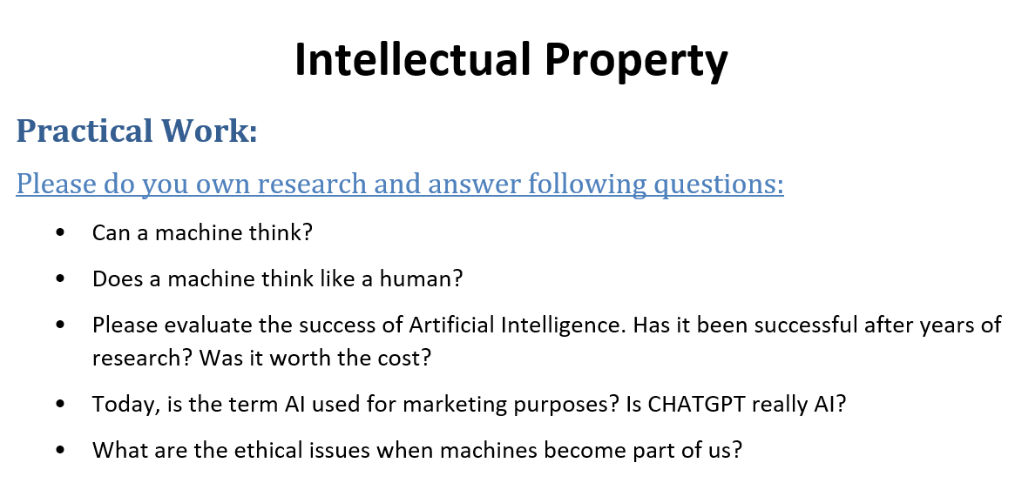

Slide 15
Group Activity 1: Exploring the Mind vs. Machine Thinking
Task: In groups, prepare a presentation comparing how the human mind and AI process information. Use the example of Google's AI development and discuss whether an AI can genuinely think or if it's simply following instructions.
Instructions:
Define what the human mind represents and how it differs from machine logic.
Analyze whether AI can replicate emotions and imagination.
Provide examples of AI systems attempting to mimic human thought.

Slide 16
Group Activity 1: Exploring the Mind vs. Machine Thinking
Presentation Points:
Differences between human and machine thinking
Key features AI lacks compared to the human mind
A real-world example (e.g., Google's AI)

Slide 17
Group Activity 2: Machine Logic in Modern Computing
Task: Create a presentation about how machine logic is used in today’s technology. Use the IBM supercomputer as an example to explain how machine logic differs from human problem-solving.
Instructions:
Explain what machine logic is and how it operates.
Compare machine logic to human thinking.
Discuss real-world applications where machine logic outperforms humans.

Slide 18
Group Activity 2: Machine Logic in Modern Computing
Presentation Points:
Definition and examples of machine logic
Comparison with human problem-solving
The role of IBM’s supercomputer in demonstrating machine logic

Slide 19
Group Activity 3: Evaluating AI and Thinking Machines
Task: Develop a presentation on whether AI, such as Tesla’s self-driving cars, can be considered thinking machines. Discuss if these cars have independent thought or if they simply follow programmed responses.

Slide 20
Group Activity 3: Evaluating AI and Thinking Machines
Instructions:
Define what it means for a machine to "think."
Evaluate Tesla's self-driving car technology.
Discuss the limitations of AI thinking compared to humans.
Presentation Points:
Explanation of AI thinking
Analysis of Tesla’s self-driving cars as thinking machines
Key differences between AI responses and human thought

Slide 21
Group Activity 4: Ethical Considerations in Machine Ethics
Task: Prepare a presentation about machine ethics using the example of a hospital robot developed by Sydney HealthTech. Discuss how machines should be programmed to make ethical decisions.
Instructions:
Define machine ethics and its importance.
Explore how ethical guidelines can be embedded in machines.
Discuss potential challenges in ensuring ethical behavior by machines

Slide 22
Group Activity 4: Ethical Considerations in Machine Ethics
Presentation Points:
Definition and importance of machine ethics
Practical challenges in programming machine ethics
How Sydney HealthTech’s robot handles ethical dilemmas

Slide 23
Group Activity 5: Intellectual Property and AI in Practice
Task: Research and present how AI, such as ChatGPT, raises intellectual property and ethical concerns. Discuss whether ChatGPT is a true representation of AI or if it's more of a marketing tool.
Instructions:
Define AI and explore whether ChatGPT fits this definition.
Discuss how AI has succeeded or failed in intellectual property matters.
Evaluate ethical issues surrounding AI’s role in content creation and originality.

Slide 24
Group Activity 5: Intellectual Property and AI in Practice
Presentation Points:
Overview of ChatGPT and its AI capabilities
Success and challenges of AI in intellectual property
Ethical implications of using AI in creative fields
These group activities encourage you to explore the concepts deeply, linking theoretical ideas with real-world applications and challenges.

